Slide 1
ER – Entity Relationship Diagram
Major components of ER diagram
Practices

Slide 2
ER
1976 proposed by Peter Chen
ER diagram is widely used in database design
  Represent conceptual level of a database system
  Describe things and their relationships in high level

Slide 3
Basic Concepts
Entity set – an abstraction of similar things, e.g. cars, students
  An entity set contains many entities
Attributes: common properties of the entities in a entity sets
Relationship – specify the relations among entities from two or more entity sets

Slide 4
Example of Elements of E-R Model
  Entity Sets
    Departments
    Professors
    Students
    Administrators
  Attributes
    Name of Departments, Phone No., Address...
    Name, SSN, Address of Professors...
  Relationship
    Students and Professors are under a certain department
    Admin manage the campus/ departments

Slide 5
Classification of Constraints
Keys
Single-value constraints
Multi-valued constraints
Mapping Cardinalities and Participation Constraints

Slide 6
Entity Sets and Key Attributes
Key – an attribute or a collection of attributes whose value(s) uniquely identify an entity in the entity set.
For instance,
• RollNumber- Key for Student entity set
• EmpID - Key for Faculty entity set
• HostelName, RoomNo - Key for Student entity set
(assuming that each student gets to stay in a single room)
A key for an entity set may have more than one attribute.
An entity set may have more than one key.
Keys can be determined only from the meaning of the attributes in the entity type.
Determined by the designers

Slide 7
Key in the E/R Model
Super Key – An attribute or a combination of attribute that is used to identify the records uniquely is known as Super Key. A table can have many Super Keys.
E.g. of Super Key
1 ID
2 ID, Name
3 ID, Address
4 ID, Department_ID
5 ID, Salary
6 Name, Address
7 Name, Address, Department_ID ………… So on as any combination which can identify the records uniquely will be a Super Key.
Candidate Key – It can be defined as minimal Super Key or irreducible Super Key
E.g. of Candidate Key: Name, Address
Combination of Name and Address can identify the record uniquely, but neither Name nor Address can be used to identify the records uniquely as it might be possible that we have two employees with similar name or two employees from the same house.

Slide 8
Primary , Foreign key
Primary Key – A Candidate Key that is used for unique identification of each row in a table is known as Primary Key. A Primary Key can consist of one or more attributes of a table.
Although several candidate keys may exist, one of the candidate keys is selected to be the primary key.
E.g. of Primary Key - Database designer can use one of the Candidate Key as a Primary Key. In this case we have “Code” and “Name, Address” as Candidate Key, we will consider “Code” Key as a Primary Key as the other key is the combination of more than one attribute.
Foreign Key – A foreign key is an attribute or combination of attribute in one base table that points to the candidate key (generally it is the primary key) of another table. The purpose of the foreign key is to ensure referential integrity of the data i.e. only values that are supposed to appear in the database are permitted.

Slide 9
Composite, Alternate key
Composite Key – If we use multiple attributes to create a Primary Key then that Primary Key is called Composite Key (also called a Compound Key or Concatenated Key).
E.g. of Composite Key, if we have used “Name, Address” as a Primary Key then it will be our Composite Key.
Alternate Key – Alternate Key can be any of the Candidate Keys except for the Primary Key.
E.g. of Alternate Key is “Name, Address” as it is the only other Candidate Key which is not a Primary Key.

Slide 10

An Example

Slide 11
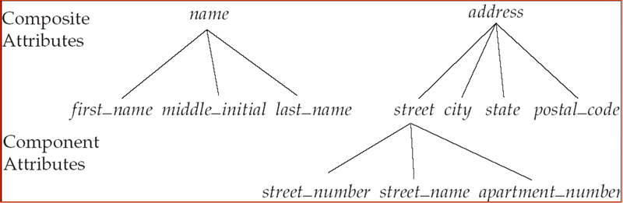
Types of Attributes
Simple Attributes
 having atomic or indivisible values.
example: Dept – a string
PhoneNumber – an eight digit number
Composite Attributes
 having several components in the value.
example: Qualification with components
(DegreeName, Year, UniversityName)

Slide 12
Derived Attributes
 Attribute value is dependent on some other attribute.
example: Age depends on DateOf Birth.
So age is a derived attribute.
Single-valued
 having only one value rather than a set of values.
example: PlaceOfBirth – single string value.
Multi-valued
 having a set of values rather than a single value.
for instance, Courses Enrolled attribute for student
Email Address attribute for student Previous Degree attribute for student.

Slide 13
Domains of Attributes
Each attribute takes values from a set called its domain
For instance, studentAge – {17,18, …, 55}
  HomeAddress – character strings of length 35
Domain of composite attributes –
cross product of domains of component attributes
Domain of multi-valued attributes –
set of subsets of values from the basic domain

Slide 14
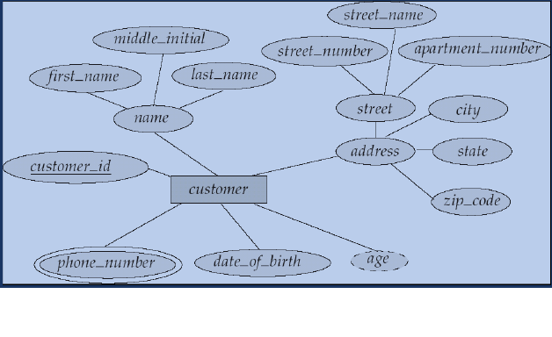
E-R Diagram With Composite,
Multivalued, and Derived Attributes

Slide 15
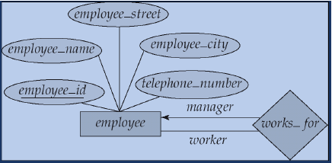
Roles
Entity sets of a relationship need not be distinct
The labels “manager” and “worker” are called roles; they specify how employee entities interact via the works for relationship set.
Roles are indicated in E-R diagrams by labeling the lines that connect diamonds to rectangles.
Role labels are optional, and are used to clarify semantics of the
relationship.

Slide 16
Relationship
A relationship may be thought as a set as well
  For binary relationship, it enumerates the pairs of entities that relate to each other
  For example, entity set M = {Mike, Jack, Tom} entity set F = {Mary, Kate}. The relationship set married between M and F may be {<Mike,Mary>,<Tom, Kate>}

Slide 17
Relationship
A relationship set is a mathematical relation among n ≥ 2 entities, each taken from entity sets
{(e₁, e₂, … e_{n}) | e₁ ∈ E₁, e₂ ∈ E₂, …, e_{n} ∈ E_{n}}
where (e₁, e₂, …, e_{n}) is a relationship
  Example:
  (Hayes, A-102) ∈ depositor

Slide 18

Relationship Example

Slide 19

Attribute of A Relationship Set

Slide 20
Relationship
The degree of a relationship = the number of entity sets that participate in the relationship
  Mostly binary relationships
  Sometimes more
Mapping cardinality of a relationship
  1 –1
  1 – many
  many – 1
  Many-many

Slide 21

One-One and One-Many

Slide 22

Many-one and many-many

Slide 23

1- many

Slide 24
Many - 1

Slide 25
Many - many

Slide 26

Alternative Cardinality Specification

Slide 27
Note on Mapping Cardinality
Both many and 1 include 0
  Meaning some entity may not participate in the relationship

Slide 28

Total Participation
When we require all entities to participate in the relationship (total participation), we use double lines to specify
Every loan has to have at least one customer

Slide 29

Self Relationship
Sometimes entities in a entity set may relate to other entities in the same set. Thus self relationship
Here employees mange some other employees
The labels “manger” and “worker” are called roles the self relationship

Slide 30
More examples on self-relationship
People to people
  Parent – children
  Manager – employee
  Husband – wife
Word to word
  Root – synonym

Slide 31
Attributes
Both entity sets and relationships can have attributes
Attributes may be
  Composite
  Multi-valued (double ellipse)
  Derive (dashed ellipse)

Slide 32

Another Example

Slide 33
Keys
A super key of an entity set is a set of one or more attributes whose values uniquely determine each entity.
A candidate key of an entity set is a minimal super key
Although several candidate keys may exist, one of the candidate keys is selected to be the primary key.

Slide 34
Key Examples
Suggest super keys for the following entity?
What are the candidate keys?
Primary key?
author
name
death
birthday
description

Slide 35

Ternary Relationship

Slide 36
Can We Decompose a Ternary Relationship?
Some relationships that appear to be non-binary may be better represented using binary relationships
  E.g. A ternary relationship parents, relating a child to his/her father and mother, is best replaced by two binary relationships, father and mother
    Using two binary relationships allows partial information (e.g. only mother being know)
  But there are some relationships that are naturally non-binary
    E.g. works-on, why?

Slide 37
Converting Ternary to binary
In general, any non-binary relationship can be represented using binary relationships by creating an artificial entity set.
  Replace R between entity sets A, B and C by an entity set E, and three relationship sets:
1. R_{A}, relating E and A 2.R_{B}, relating E and B
3. R_{C}, relating E and C
  Create a special identifying attribute for E
  Add any attributes of R to E
  For each relationship (a_{i} , b_{i} , c_{i}) in R, create
1. a new entity e_{i} in the entity set E 2. add (e_{i} , a_{i} ) to R_{A}
3. add (e_{i} , b_{i} ) to R_{B} 4. add (e_{i} , c_{i} ) to R_{C}

Slide 38

Converting Ternary to binary

Slide 39
Design an ER Diagram
Design a database for an on-line reservation system for microscopes in material science lab
There are two types of users: microscope administrators and microscope end users
Each microscope is located in a specific lab
Each request is assigned to an administrator who can authorize or deny the request
Using of some microscope requires the presence of an administrator
Time is divided into 1 hour slots. Each reservation can only take one or more time slots

Slide 40
Weak Entity Set
Some entity sets in real world naturally depend on some other entity set
  They can be uniquely identified only if combined with another entity set
Example:
  section1, section2, … become unique only if you put them into a context, e.g. csce4350

Slide 41

Weak Entity Set Notations
Double rectangles for weak entity set
Double diamond for weak entity relationship
Dashed underscore for discriminator

Slide 42
Specialization
A lower-level entity set inherits all the attributes and relationship participation of the higher-level entity set to which it is linked.
A lower-level entity set may have additional attributes and participate in additional relationships

Slide 43


Slide 44
Specification
Disjoint
Completeness constraint (use double lines)
  total : an entity must belong to one of the lower-level entity sets
  partial: an entity need not belong to one of the lower-level entity sets

Slide 45
Design Considerations
Use of entity sets vs. attributes
  Whether we want to keep additional information
Use of entity sets vs. relationship sets
  Actions among entities are usually represented by relationships
Binary versus n-ary relationship sets
  N-nary relationships are usually more natural for actions among entity sets
Weak entity set vs. strong entity set
Generalization

Slide 46

Notations

Slide 47
Notations

Slide 48
ER Practice Again
Design an ER diagram for an online music store. The database will contain at least the following concepts: songs, artists, bands, albums, and genres.
State your design assumptions you make to support design decisions. Be sure your assumptions are reasonable.

Slide 49
Best Practice Guide for ER Design
Use of entity sets vs. attributes
Use of entity sets vs. relationship sets
Binary versus n-ary relationship sets
Weak entity set vs. strong entity set
  Choose the natural one
Generalization
  If specialized entities need to keep additional information and participate in additional relationships

Slide 50
ER for Banking Enterprise
Description handhout

Slide 51
Read ER Diagrams
Following are some ER diagrams grabbed from the web
Read to understand/criticize

Slide 52
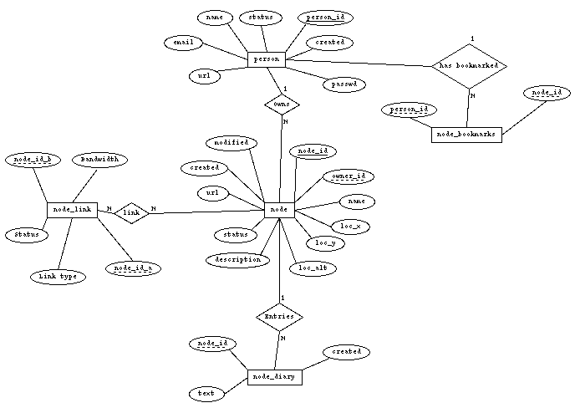
?
?
?
?
?
?
?
?
?

Slide 53
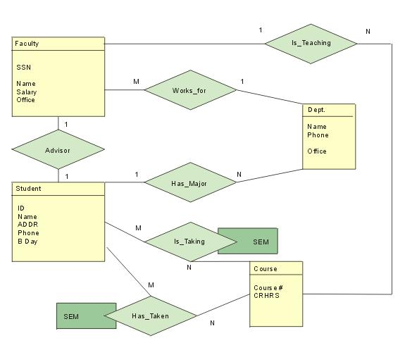
?
?
?
?
?
Yan Huang -CSCE4350 - ER

Slide 54
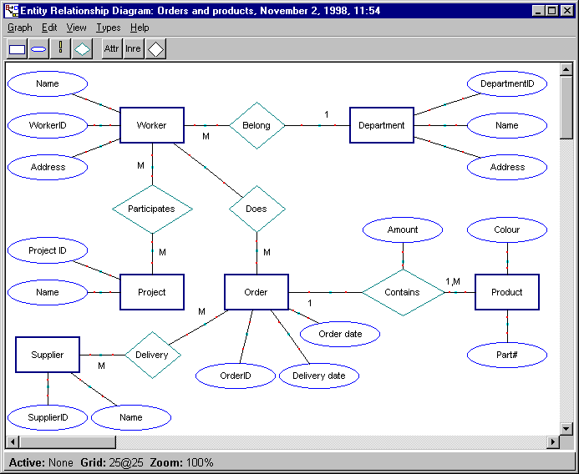
?
Yan Huang -CSCE4350 - ER

Slide 55
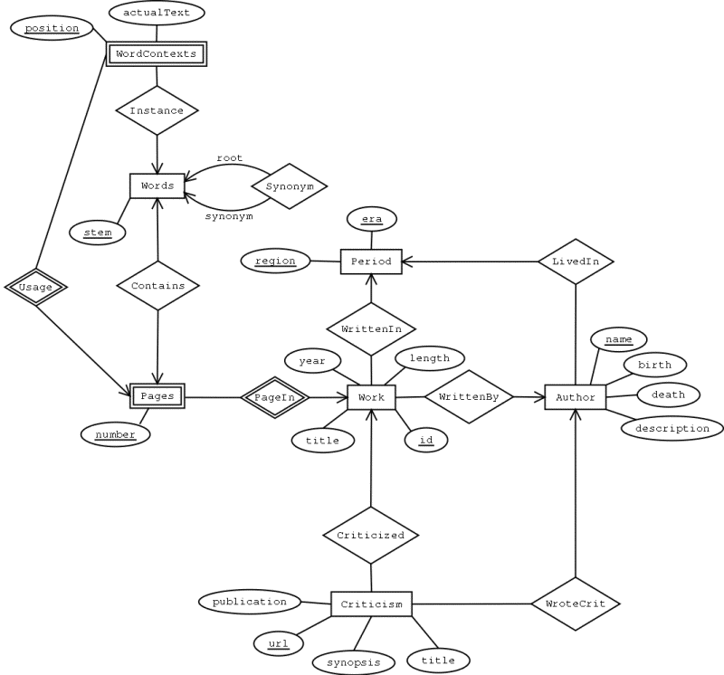
Yan Huang -CSCE4350 - ER

Slide 56
Make An ER diagram for the following scenario
We can now define the entity types for the COMPANY database, based on the following description: An entity type DEPARTMENT with attributes Name, Number, Locations, Manager, and ManagerStartDate. Locations is the only multivalued attribute. We can specify that both Name and Number are (separate) key attributes, because each was specified to be unique. An entity type PROJECT with attributes Name, Number, Location, and ControllingDepartment. Both Name and Number are (separate) key attributes. An entity type EMPLOYEE with attributes Name, SSN (for social security number), Sex, Address, Salary, BirthDate, Department, and Supervisor. Both Name and Address may be composite attributes; however, this was not specified in the requirements. We must go back to the users to see if any of them will refer to the individual components of Name—FirstName, MiddleInitial, LastName—or of Address. An entity type DEPENDENT with attributes Employee, DependentName, Sex, BirthDate, and Relationship (to the employee). So far, we have not represented the fact that an employee can work on several projects, nor have we represented the number of hours per week an employee works on each project. This characteristic a multivalued composite attribute of EMPLOYEE called WorksOn with simple components (Project, Hours). Alternatively, it can be represented as a multivalued composite attribute of PROJECT called Workers with simple components (Employee, Hours). We choose the first alternative in Figure 03.08, which shows each of the entity types described above. The Name attribute of EMPLOYEE is shown as a composite attribute, presumably after consultation with the users.

Slide 57
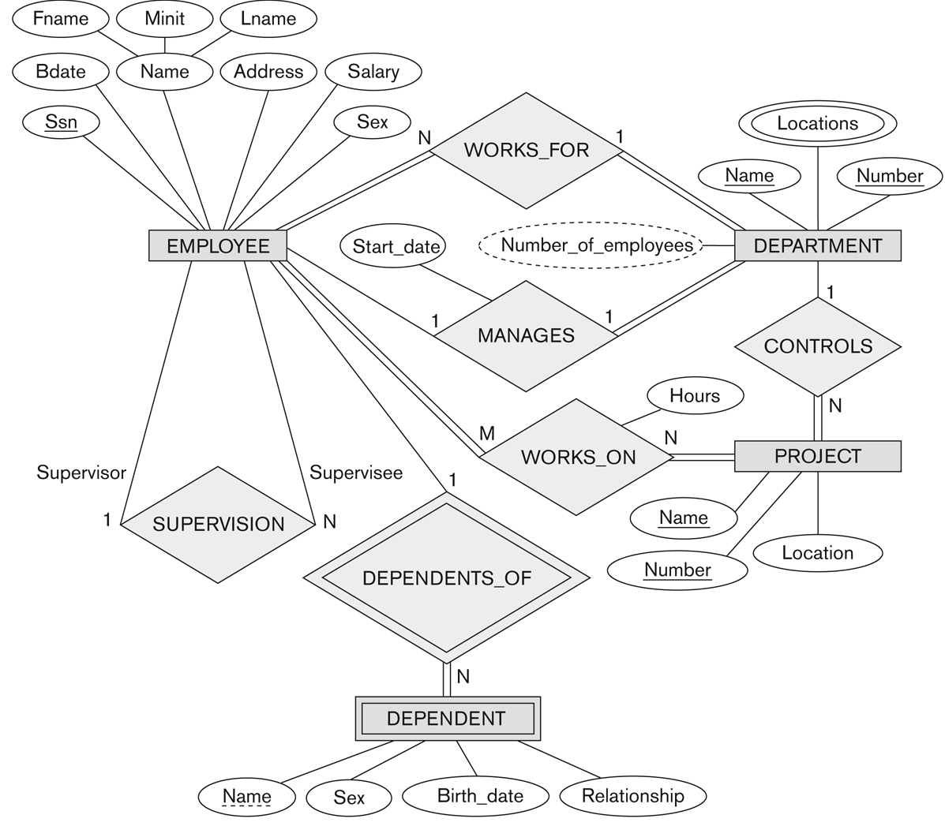
ER schema diagram for Company database

Slide 58
ER Diagram
Question 1: Practice ER Diagram Question – A Sample Solution Suppose you are given the following requirements for a simple database for the National Hockey League (NHL): · the NHL has many teams, · each team has a name, a city, a coach, a captain, and a set of players, · each player belongs to only one team, · each player has a name, a position (such as left wing or goalie), a skill level, and a set of injury records, · a team captain is also a player, · a game is played between two teams (referred to as host_team and guest_team) and has a date (such as May 11th, 1999) and a score (such as 4 to 2).

Slide 59
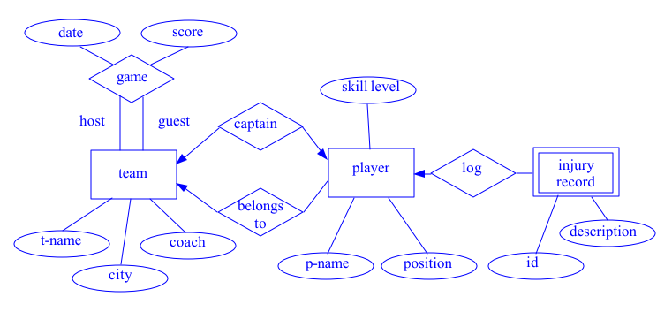
Solution

Slide 60
ER Diagram
Question 2: A university registrar’s office maintains data about the following entities:
courses, including number, title, credits, syllabus, and prerequisites;
course offerings, including course number, year, semester, section number, instructor(s), timings, and classroom;
students, including student-id, name, and program;
instructors, including identication number, name, department, and title.
Further, the enrollment of students in courses and grades awarded to students in each course they are enrolled for must be appropriately modeled. Construct an E-R diagram for the registrar’s ofce.Document all assumptions that you make about the mapping constraints.

Slide 61
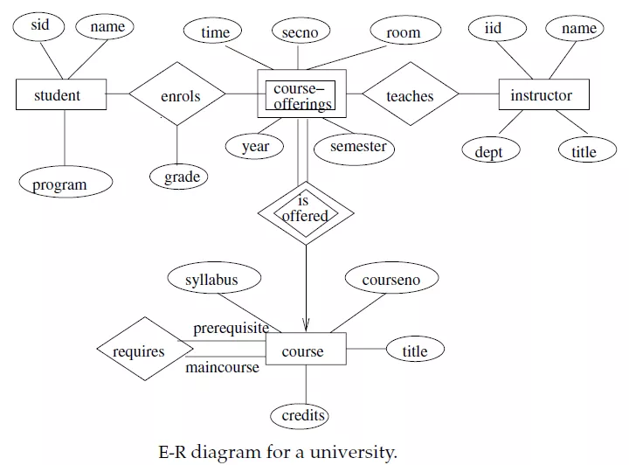
Solution

